Slide 1
Stabilizing Queuing Network with Model Data-Independent Control
Qian Xie
qx66@cornell.edu
Joint work with Li Jin (SJTU, NYU)

Slide 2
Robust routing for queuing networks
In practical settings, model data (arrival/service rates) may be
unavailable
hard to estimate

Slide 3
















Robust routing for queuing networks
In practical settings, model data (arrival/service rates) may be
unavailable
hard to estimate
Suppose that we know the traffic state and network topology, but not the demand and supply
$$λ_{2}$$
$${\overline{μ}}_{1}$$
$$S_{2}$$
$${\overline{μ}}_{2}$$
$${\overline{x}}_{1}$$
$${\overline{x}}_{2}$$
$$λ_{1}$$
$$S_{1}$$
$${\overline{μ}}_{4}$$
$${\overline{x}}_{3}$$
$${\overline{μ}}_{3}$$
$${\overline{μ}}_{5}$$
$$T_{2}$$
$${\overline{x}}_{4}$$
$${\overline{x}}_{5}$$
$$T_{1}$$

Slide 4
















Robust routing for queuing networks
In practical settings, model data (arrival/service rates) may be
unavailable
hard to estimate
Suppose that we know the traffic state and network topology, but not the demand and supply
$$？$$
$$？$$
$$S_{2}$$
$$？$$
$${\overline{x}}_{1}$$
$${\overline{x}}_{2}$$
$$？$$
$$S_{1}$$
$$？$$
$${\overline{x}}_{3}$$
$$？$$
$$？$$
$$T_{2}$$
$${\overline{x}}_{4}$$
$${\overline{x}}_{5}$$
$$T_{1}$$

Slide 5
Learning-based vs. robust control
How to make queuing control decisions in an unknown environment?

Slide 6
Learning-based vs. robust control
How to make queuing control decisions in an unknown environment?
Solution 1: learn the environment from observation
learning-based adaptive control
efficient & smart
require sufficient data
vulnerable to unhealthy data

Slide 7
Learning-based vs. robust control
How to make queuing control decisions in an unknown environment?
Solution 1: learn the environment from observation
learning-based adaptive control
efficient & smart
require sufficient data
vulnerable to unhealthy data
Solution 2: independent of environment parameters
robust control
easy & robust
guarantee stability but not efficiency
resist modeling error and/or non-stationary environment

Slide 8
Learning-based vs. robust control
How to make queuing control decisions in an unknown environment?
Solution 1: learn the environment from observation
learning-based adaptive control
efficient & smart
require sufficient data
vulnerable to unhealthy data
Solution 2: independent of environment parameters
robust control
easy & robust
guarantee stability but not efficiency
resist modeling error and/or non-stationary environment
Solution 2 motivates model-based independent control

Slide 9















Setting
Multi-class Jackson queueing network
Open, acyclic, multiple origin-destination (OD)
Poisson arrivals & exponential service times
Real-time OD-specific queue sizes can be observed
$$λ_{2}$$
$${\overline{μ}}_{1}$$
$$S_{2}$$
$${\overline{μ}}_{2}$$
$${\overline{x}}_{1}$$
$${\overline{x}}_{2}$$
$$λ_{1}$$
$$S_{1}$$
$${\overline{μ}}_{4}$$
$${\overline{x}}_{3}$$
$${\overline{μ}}_{3}$$
$${\overline{μ}}_{5}$$
$$T_{2}$$
$${\overline{x}}_{4}$$
$${\overline{x}}_{5}$$
$$T_{1}$$

Slide 10
















Setting
Multi-class Jackson queueing network
Open, acyclic, multiple origin-destination (OD)
Poisson arrivals & exponential service times
Real-time OD-specific queue sizes can be observed
MDI control actions
Routing
Sequencing
e.g., FCFS, preemptive-priority
Holding
$$λ_{2}$$
$${\overline{μ}}_{1}$$
$$S_{2}$$
$${\overline{μ}}_{2}$$
$${\overline{x}}_{1}$$
$${\overline{x}}_{2}$$
$$λ_{1}$$
$$S_{1}$$
$${\overline{μ}}_{4}$$
$${\overline{x}}_{3}$$
$${\overline{μ}}_{3}$$
$${\overline{μ}}_{5}$$
$$T_{2}$$
$${\overline{x}}_{4}$$
$${\overline{x}}_{5}$$
$$T_{1}$$

Slide 11
Main results
Easy-to-use criterion to check the stability of a multi-class network under a given MDI control policy
Stabilizing centralized MDI routing + sequeuncing policy for multi-class network (JSR)
Stabilizing decentralized MDI routing + holding policy for single-class network (JSQ-AS)

Slide 12
Naïve policy: JSQ
Simple case: parallel queues
Intuitive routing policy: join the shortest queue (JSQ)
Route the arrival to the shortest queue
Ties are broken uniformly at random
Standard results:
System is stable if and only if arrival rate < total service rate
Optimal for symmetric servers
JSQ is MDI, decentralized and throughput-maximizing

Slide 13









JSQ fails for networks
What if we directly extend JSQ to networks?
$${\overline{μ}}_{1}=1$$
$${\overline{μ}}_{2}=0.1$$
$${\overline{x}}_{1}$$
$${\overline{x}}_{2}$$
$$λ=1$$
origin
JSQ
destination
$${\overline{x}}_{3}$$
$${\overline{x}}_{4}$$
${\overline{μ}}_{3}$ = 1
$${\overline{μ}}_{4}=1$$

Slide 14




JSQ fails for networks
What if we directly extend JSQ to networks?
By symmetry & Burke’s theorem, departure process from servers 1 & 3 are both Poisson(0.5)
However, 0.5 > 0.1 (service rate of server 2)
Thus, the network is unstable!
$${\overline{μ}}_{1}=1$$
$${\overline{μ}}_{2}=0.1$$
$${\overline{x}}_{1}$$
$${\overline{x}}_{2}$$
$$λ=1$$
origin
JSQ
destination
$${\overline{x}}_{3}$$
$${\overline{x}}_{4}$$
${\overline{μ}}_{3}$ = 1
$${\overline{μ}}_{4}=1$$

Slide 15









JSQ fails for networks
Why JSQ fails?
Server 2 will be congested, but such information is not used at the origin
$${\overline{μ}}_{1}=1$$
$${\overline{μ}}_{2}=0.1$$
$${\overline{x}}_{1}$$
$${\overline{x}}_{2}$$
$$λ=1$$
origin
JSQ
destination
$${\overline{x}}_{3}$$
$${\overline{x}}_{4}$$
${\overline{μ}}_{3}$ = 1
$${\overline{μ}}_{4}=1$$

Slide 16



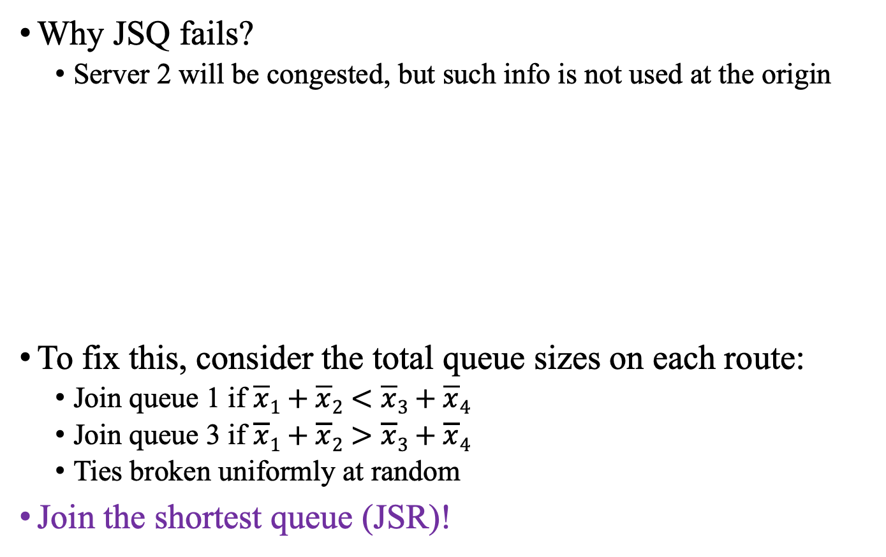





Solution: JSR
Why JSQ fails?
Server 2 will be congested, but such info is not used at the origin
To fix this, consider the total queue sizes on each route:
Join queue 1 if $\overline{x}1+\overline{x}2<\overline{x}3+\overline{x}4$
Join queue 3 if $\overline{x}1+\overline{x}2>\overline{x}3+\overline{x}4$
Ties broken uniformly at random
Join the shortest queue (JSR)!
$${\overline{μ}}_{1}=1$$
$${\overline{μ}}_{2}=0.1$$
$${\overline{x}}_{1}$$
$${\overline{x}}_{2}$$
$$λ=1$$
origin
JSQ
destination
$${\overline{x}}_{3}$$
$${\overline{x}}_{4}$$
${\overline{μ}}_{3}$ = 1
$${\overline{μ}}_{4}=1$$

Slide 17














How about more complex networks?
What if the network is multi-class and not series-parallel?
$$λ_{2}$$
$${\overline{μ}}_{1}=1$$
$$S_{2}$$
$${\overline{μ}}_{2}=1$$
$${\overline{x}}_{1}$$
$${\overline{x}}_{2}$$
$$λ_{1}$$
$$S_{1}$$
$${\overline{x}}_{3}$$
$${\overline{μ}}_{3}=1/4$$
$$T_{2}$$
$${\overline{x}}_{4}$$
$${\overline{x}}_{5}$$
$${\overline{μ}}_{4}=1$$
$$T_{1}$$
$${\overline{μ}}_{5}=1$$

Slide 18
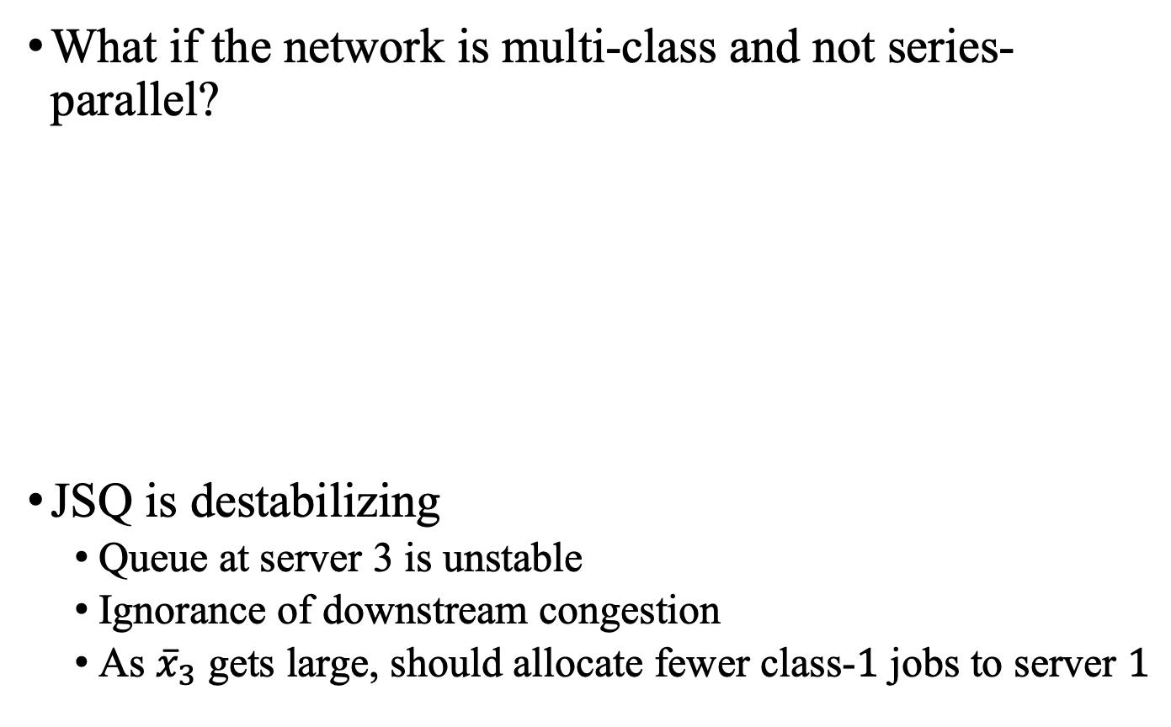
How about more complex networks?
What if the network is multi-class and not series-parallel?
JSQ is destabilizing
Queue at server 3 is unstable
Ignorance of downstream congestion
As ${\overline{x}}_{3}$ gets large, should allocate fewer class-$1$ jobs to server $1$
$$λ_{2}$$
$${\overline{μ}}_{1}=1$$
$$S_{2}$$
$${\overline{μ}}_{2}=1$$
$${\overline{x}}_{1}$$
$${\overline{x}}_{2}$$
$$λ_{1}$$
$$S_{1}$$
$${\overline{x}}_{3}$$
$${\overline{μ}}_{3}=1/4$$
$$T_{2}$$
$${\overline{x}}_{4}$$
$${\overline{x}}_{5}$$
$${\overline{μ}}_{4}=1$$
$$T_{1}$$
$${\overline{μ}}_{5}=1$$

Slide 19
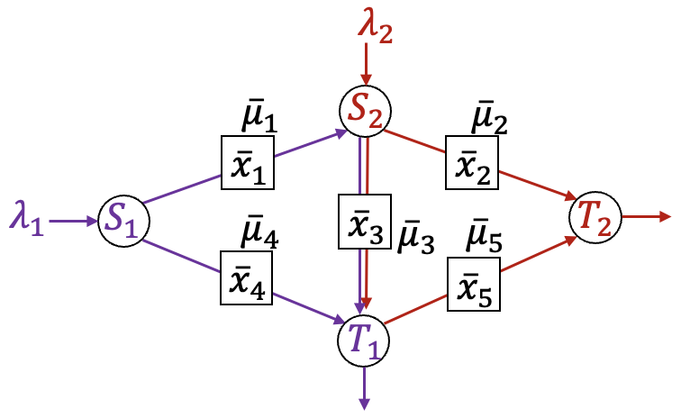
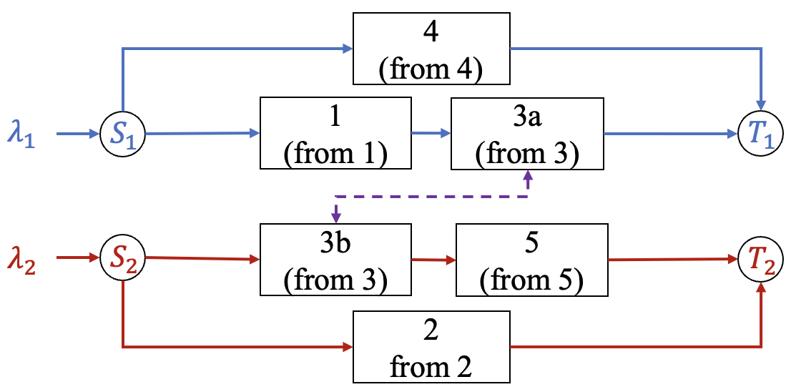
How about more complex networks?
What if the network is multi-class and not series-parallel?
Consider expanded network

Slide 20
How about more complex networks?
Consider a multi-class network and its route expansion
How to extend the previous route-sum?

Slide 21
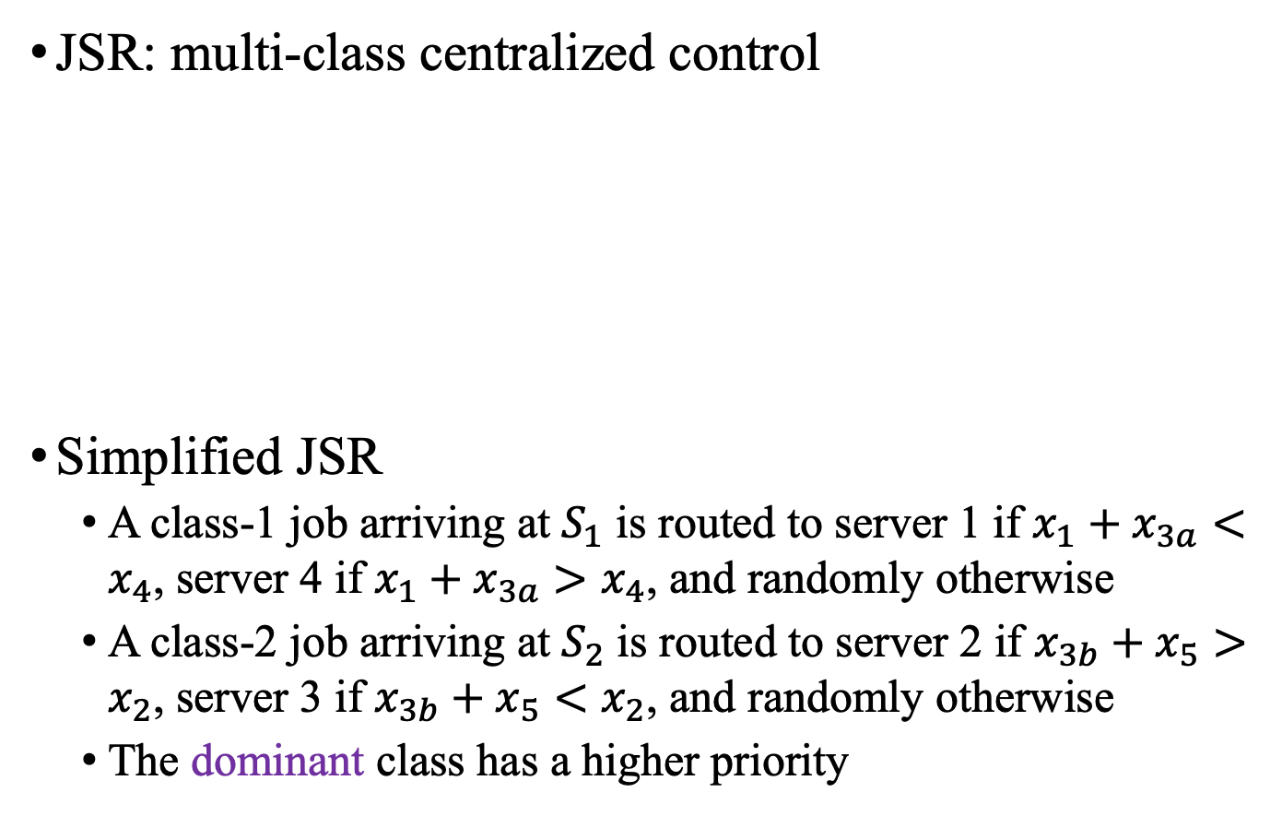
JSR for multi-class
JSR: multi-class centralized control
Simplified JSR
A class-1 job arriving at $S_{1}$ is routed to server 1 if $x_{1}+x_{3a}<x_{4}$, server 4 if $x_{1}+x_{3a}>x_{4}$, and randomly otherwise
A class-2 job arriving at $S_{2}$ is routed to server 2 if $x_{3b}+x_{5}>x_{2}$, server 3 if $x_{3b}+x_{5}<x_{2}$, and randomly otherwise
The dominant class has a higher priority

Slide 22

JSR for multi-class
JSR: multi-class centralized control
$f_{\left(1,3\right)}\left(x\right)=\max\left\{x_{1}, α\left(x_{1}+x_{3a}\right)\right\}, f_{(4)}\left(x\right)=x_{4}$
A class-1 job joins the “shorter” route between (1,3) and (4)
$f_{\left(3,5\right)}\left(x\right)=\max\left\{x_{3b}, α\left(x_{3b}+x_{5}\right)\right\}, f_{(2)}\left(x\right)=x_{2}$
A class-2 job joins the “shorter” route between (3,5) and (2)
Prioritize dominant class (imaginary service rate control)

Slide 23
Stability of the expanded network
How can we tell if an expanded network is stable under a specific control policy?

Slide 24
Stability of the expanded network
How can we tell if an expanded network is stable under a specific control policy?
Proof based on piecewise-linear test function
As long as a piecewise-linear test function can be determined, one can always develop a smooth Lyapunov function to verify the Foster-Lyapunov stability criterion [Down & Meyn, 1997]
LP-based construction [Down & Meyn, 1997]
Rely on knowledge of model data and solving optimization

Slide 25
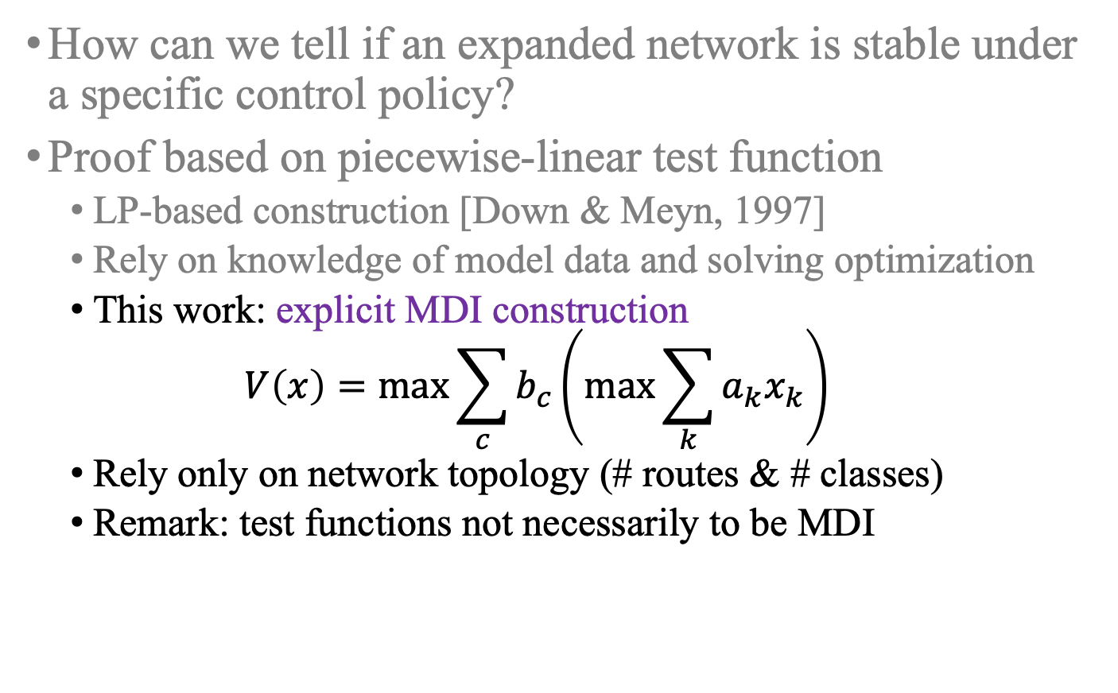
Stability of the expanded network
How can we tell if an expanded network is stable under a specific control policy?
Proof based on piecewise-linear test function
LP-based construction [Down & Meyn, 1997]
Rely on knowledge of model data and solving optimization
This work: explicit MDI construction
$$V\left(x\right)=max\sum_{c}{b_{c}}\left(max\sum_{k}{a_{k}x_{k}}\right)$$
Rely only on network topology (# routes & # classes)
Remark: test functions not necessarily to be MDI

Slide 26
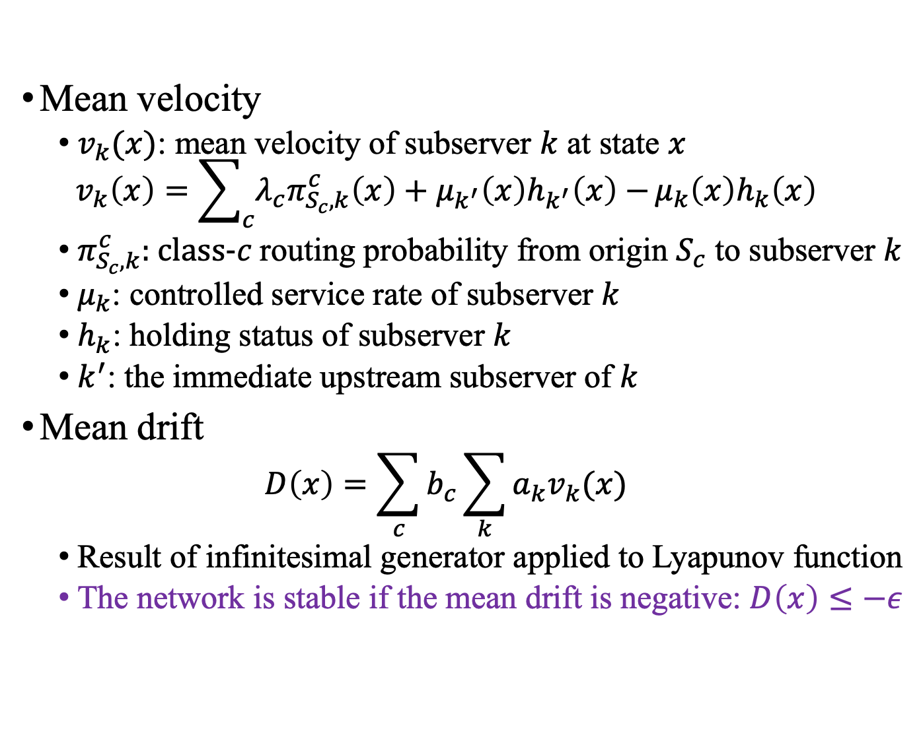
Stability of the expanded network
Mean velocity
$v_{k}(x)$: mean velocity of subserver $k$ at state $x$
$$v_{k}\left(x\right)=\sum_{c}{λ_{c}π_{S_{c},k}^{c}\left(x\right)+μ_{k^{′}}\left(x\right)h_{k^{′}}\left(x\right)−}μ_{k}\left(x\right)h_{k}\left(x\right)$$
$π_{S_{c},k}^{c}$: class-$c$ routing probability from origin $S_{c}$ to subserver $k$
$μ_{k}$: controlled service rate of subserver $k$
$h_{k}$: holding status of subserver $k$
$k^{′}$: the immediate upstream subserver of $k$
Mean drift
$$D\left(x\right)=\sum_{c}{b_{c}}\sum_{k}{a_{k}v_{k}(x)}$$
Result of infinitesimal generator applied to Lyapunov function
The network is stable if the mean drift is negative: $D\left(x\right)≤−ε$

Slide 27
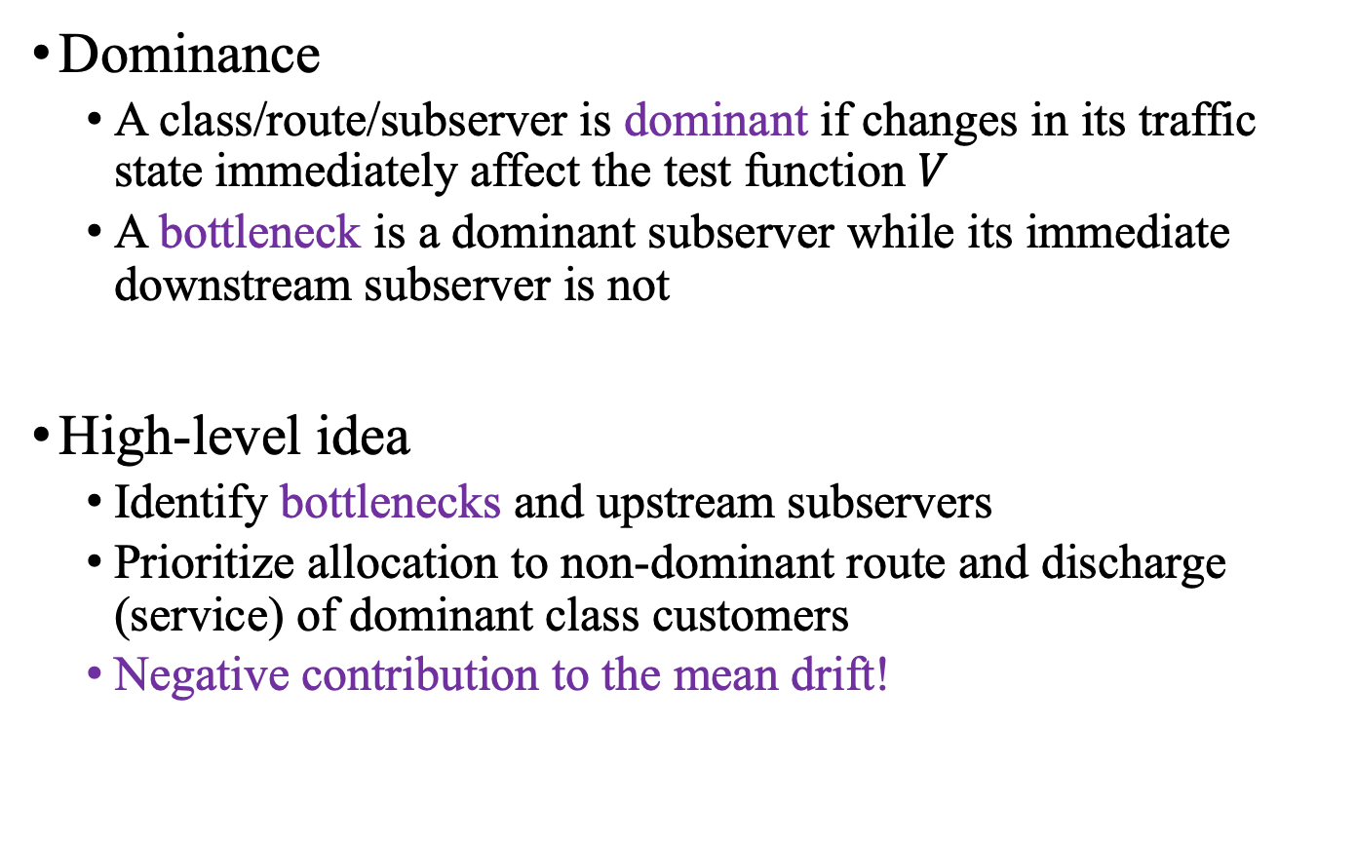
Stability of JSR policy
Dominance
A class/route/subserver is dominant if changes in its traffic state immediately affect the test function $V$
A bottleneck is a dominant subserver while its immediate downstream subserver is not
High-level idea
Identify bottlenecks and upstream subservers
Prioritize allocation to non-dominant route and discharge (service) of dominant class customers
Negative contribution to the mean drift!

Slide 28








Stability of JSR policy
Consider the expanded network
Test function construction
$f_{\left(1,3\right)}\left(x\right)=\max\left\{x_{1}, α\left(x_{1}+x_{3a}\right)\right\}, f_{(4)}\left(x\right)=x_{4}$
$g_{1}\left(x\right)=max⁡\{f_{\left(1,3\right)}\left(x\right), f_{\left(4\right)}\left(x\right), β(f_{\left(1,3\right)}\left(x\right)+f_{\left(4\right)}\left(x\right))\}$
$V(x)=max⁡\{g_{1}(x), g_{2}(x), γ(g_{1}\left(x\right)+g_{2}(x)\}$
4
(from 4)
$$λ_{1}$$
$$S_{1}$$
1
(from 1)
3a
(from 3)
$$T_{1}$$
$$λ_{2}$$
$$S_{2}$$
3b
(from 3)
5
(from 5)
$$T_{2}$$
2
from 2
$$α=β≥\frac{3}{4}$$
$$γ≥\frac{1}{2}$$

Slide 29
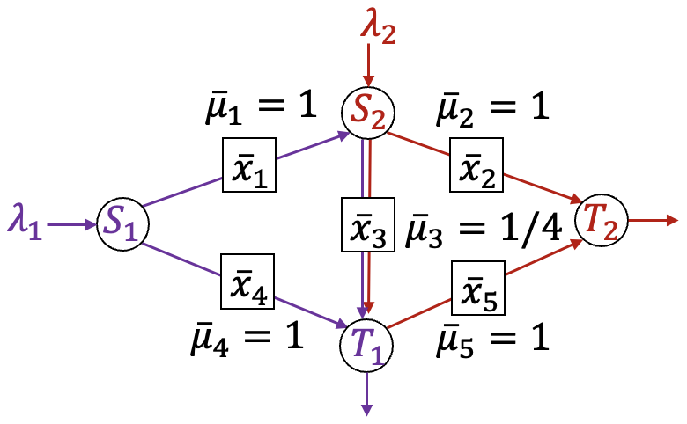

Stability of JSR policy
Consider a numerical example
The network can be stabilized by the JSR policy if and only if
$$λ_{1}<1, λ_{2}<1, λ_{1}+λ_{2}<9/4$$

Slide 30
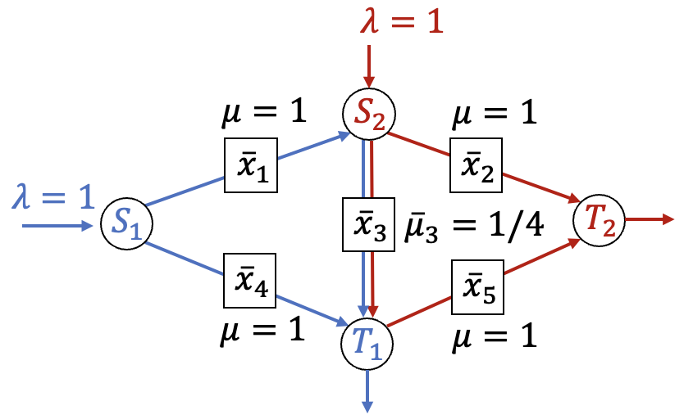

Stability of JSR policy
Consider a numerical example
Consider the following parameters for test functions:
$$α=β=γ=\frac{3}{4}, ε={\left(\frac{3}{4}\right)}^{3}$$
Case 1: only one route is dominant, incoming job allocated to non-dominant route
$$D\left(x\right)≤−γβαμ=−{\left(\frac{3}{4}\right)}^{3}≤−ε$$

Slide 31

Stability of JSR policy
Consider a numerical example
Consider the following parameters for test functions:
$$α=β=γ=\frac{3}{4}, ε={\left(\frac{3}{4}\right)}^{3}$$
Case 2: two routes with different OD are dominant, incoming job allocated to non-dominant route
$$D\left(x\right)≤−γβαμ=−{\left(\frac{3}{4}\right)}^{3}≤−ε$$

Slide 32

Stability of JSR policy
Consider a numerical example
Consider the following parameters for test functions:
$$α=β=γ=\frac{3}{4}, ε={\left(\frac{3}{4}\right)}^{3}$$
Case 3: two routes with same OD or more than two routes are dominant, incoming job allocated to a random dominant route
$$D\left(x\right)≤γβ(λ−μ−αμ)=−{\left(\frac{3}{4}\right)}^{3}≤−ε$$

Slide 33











Extend JSQ to decentralized setting
How about decentralized setting?
The decision at each server is based on local traffic info
Recall: JSQ fails for network
Queue at server 5 is unstable
Congestion info not propagated to upstream servers
$${\overline{μ}}_{1}=3/4$$
$${\overline{μ}}_{2}=3/4$$
$${\overline{x}}_{1}$$
$${\overline{x}}_{2}$$
$$λ=1$$
origin
$${\overline{x}}_{3}$$
$${\overline{μ}}_{3}=3/4$$
destination
$${\overline{x}}_{4}$$
$${\overline{x}}_{5}$$
$${\overline{μ}}_{4}=3/4$$
$${\overline{μ}}_{5}=3/4$$

Slide 34
















Extend JSQ to decentralized setting
Recall why JSQ fails
Congestion info not propagated to upstream servers
Solution: artificial holding
keep upstream queue size > downstream queue size
e.g., subserver 3 is not allowed to discharge if $x_{3}≤x_{5b}$
JSQ with artificial spillback (JSQ-AS)!
route (1,2)
$$μ_{1a}$$
$$μ_{2}$$
$$x_{1a}$$
$$x_{2}$$
$$μ_{1b}$$
$$μ_{3}$$
$$μ_{5a}$$
route (1,3,5)
$$λ$$
origin
$$x_{1b}$$
$$x_{3}$$
$$x_{5a}$$
destination
$$x_{4}$$
$$x_{5b}$$
$$μ_{4}$$
$$μ_{5b}$$
route (4,5)

Slide 35
















JSQ-AS for single class
route (1,2)
JSQ-AS: decentralized control for single class
Routing: discharge job to shortest downstream queue
Holding: a completed job is held if current queue size $≤$ the immediate downstream queue size
Imaginary switch (on expanded network): discharge job to the downstream of dominant subserver
$$μ_{1a}$$
$$μ_{2}$$
$$x_{1a}$$
$$x_{2}$$
$$μ_{1b}$$
$$μ_{3}$$
$$μ_{5a}$$
route (1,3,5)
$$λ$$
origin
$$x_{1b}$$
$$x_{3}$$
$$x_{5a}$$
destination
$$x_{4}$$
$$x_{5b}$$
$$μ_{4}$$
$$μ_{5b}$$
route (4,5)

Slide 36

Stability of JSQ-AS
route (1,2)
Consider an alternative test function:
$f_{1}(x)=max⁡\{x_{1a},{\frac{1+δ}{2}(x}_{1a}+x_{2})\}$
$f_{2}(x)=max⁡\{x_{1b},{\frac{1+δ}{2}(x}_{1b}+x_{3}),{\frac{1+2δ}{3}(x}_{1b}+x_{3}+x_{5a})\}$
$f_{3}(x)=max⁡\{x_{4},{\frac{1+δ}{2}(x}_{4}+x_{5b})\}$
$V\left(x\right)=max⁡\{f_{1}\left(x\right),f_{2}\left(x\right),f_{3}\left(x\right)\}$
$$μ_{1a}$$
$$μ_{2}$$
$$x_{1a}$$
$$x_{2}$$
$$μ_{1b}$$
$$μ_{3}$$
$$μ_{5a}$$
route (1,3,5)
$$λ$$
origin
$$x_{1b}$$
$$x_{3}$$
$$x_{5a}$$
destination
$$x_{4}$$
$$x_{5b}$$
$$μ_{4}$$
$$μ_{5b}$$
route (4,5)

Slide 37
Stability of JSQ-AS
route (1,2)
High-level idea:
Bottlenecks are nonempty and not in the holding status
Thus, bottlenecks can discharge customers and contribute negative terms to the drift
Either the route with the smallest first subserver queue length is non-dominant or every route is dominant
Thus, incoming job is routed to a non-dominant route if exists
$$μ_{1a}$$
$$μ_{2}$$
$$x_{1a}$$
$$x_{2}$$
$$μ_{1b}$$
$$μ_{3}$$
$$μ_{5a}$$
route (1,3,5)
$$λ$$
origin
$$x_{1b}$$
$$x_{3}$$
$$x_{5a}$$
destination
$$x_{4}$$
$$x_{5b}$$
$$μ_{4}$$
$$μ_{5b}$$
route (4,5)

